Slide 1
driver drowsiness detection system using neural networks:
Dr. Ibrahim Zaghloul
En. Sara Abd Elmaohsen
Team:
كريم عمران إبراهيم العتبانى
محمد خالد عبد العليم حرب
كريم عماد عبد الغفار
كريم ايهاب محمد عبد المقصود

Slide 2
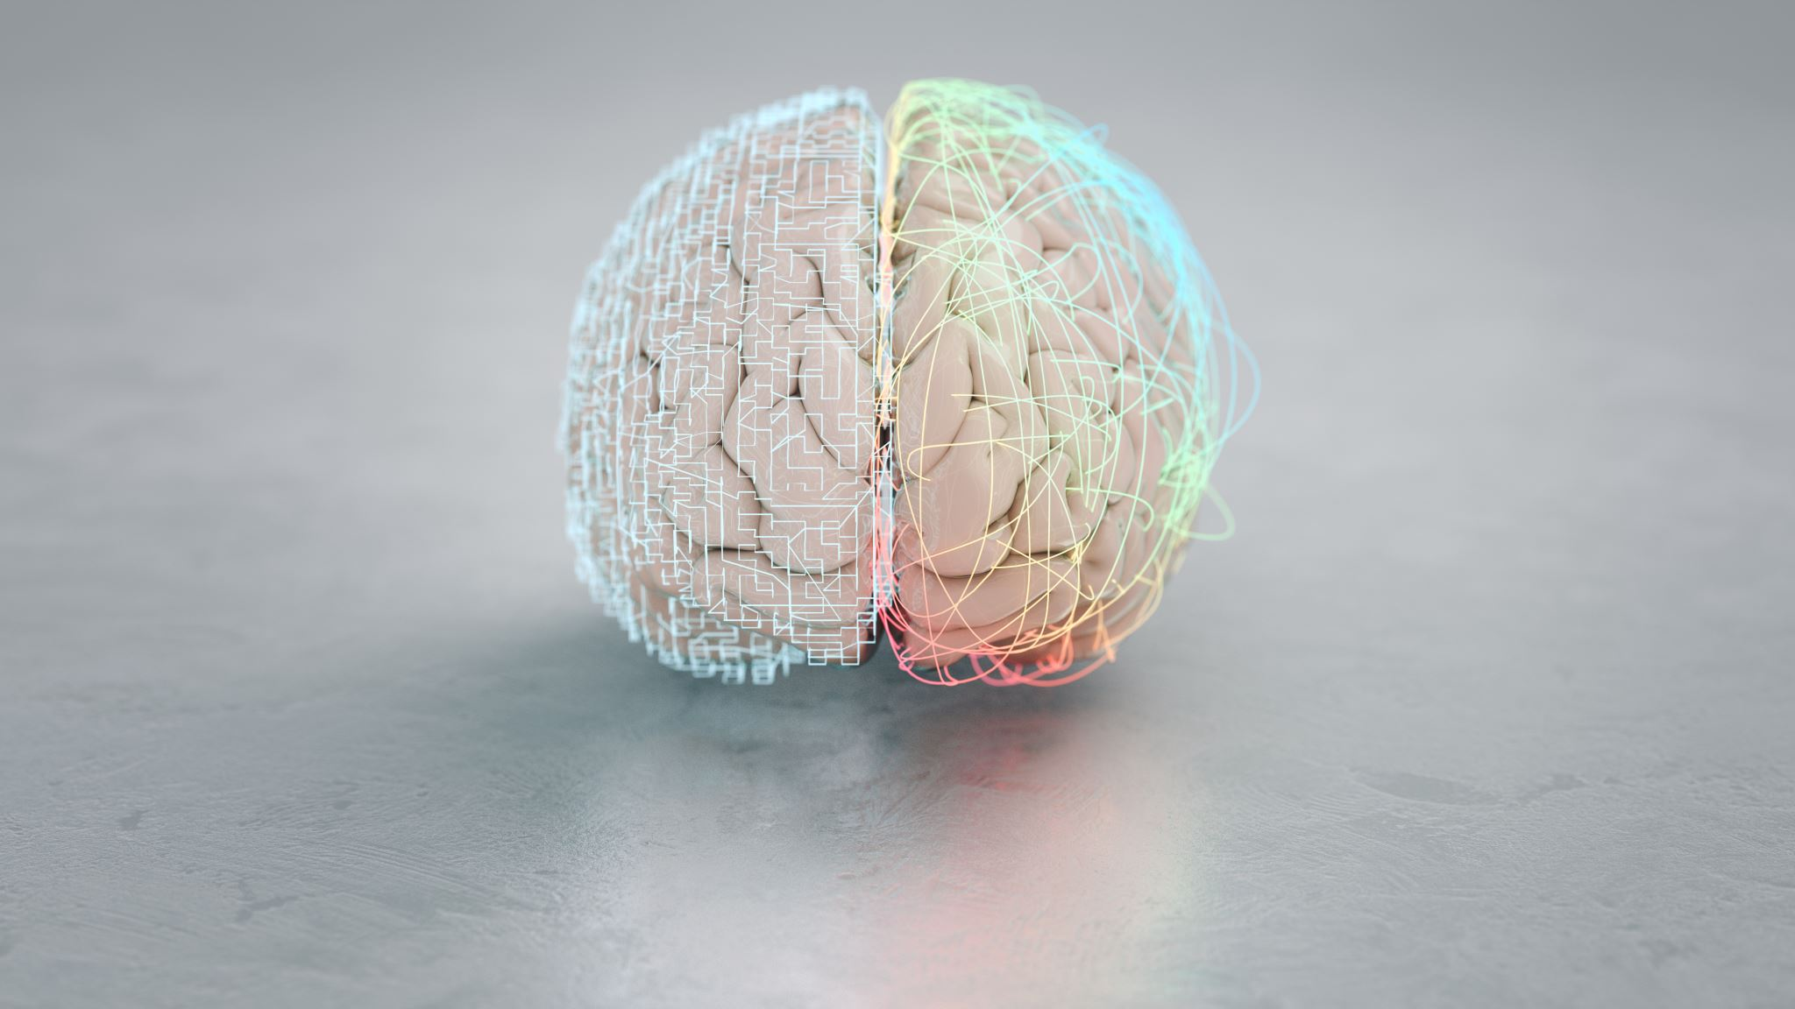
Abstract
Driver drowsiness is a specific form of drowsiness that poses a significant risk to road safety. It is a state of reduced alertness and impaired cognitive function that can occur when a driver is fatigued, sleep-deprived, or under the influence of medication or drugs.
Driver drowsiness is a complex problem that involves both individual and systemic factors. Individual factors include sleep quality, duration, and timing, as well as lifestyle factors such as alcohol consumption and stress. Systemic factors include work schedules, road infrastructure, and driving regulations.
The consequences of driver drowsiness can be severe, including an increased risk of accidents, injuries, and fatalities. As such, there is a growing need for effective strategies to detect and prevent driver drowsiness.
In recent years, there has been a significant focus on developing technology-based solutions for detecting and addressing driver drowsiness. These include systems that monitor driver behavior and physiological responses, such as eye movements and heart rate variability. Other strategies involve education and awareness campaigns, regulations and policies that promote healthy sleep habits, and workplace interventions to reduce the risk of drowsiness on the job.
Overall, addressing driver drowsiness requires a multifaceted approach that considers individual and systemic factors, incorporates technology and education, and involves collaboration among various stakeholders, including drivers, employers, policymakers, and healthcare professionals.

Slide 3
Introduction
Neural networks can be used to develop predictive models for detecting drowsiness in real-time based on patterns in physiological and behavioral data. These models can be trained on large datasets that include measures such as heart rate, eye movements, and brain activity, which have been shown to be reliable indicators of drowsiness.
Once the neural network has been trained, it can be used to predict the likelihood of drowsiness in real-time based on the input data. This can be used to provide alerts or warnings to individuals who are at risk of falling asleep, such as drivers or operators of heavy machinery.
Overall, the use of neural networks in addressing drowsiness holds great promise for improving safety and productivity in a range of settings. However, it is important to note that these approaches require careful validation and testing to ensure their effectiveness and safety.

Slide 4
Problem
Driver drowsiness is a significant problem that can impair a driver's ability to operate a vehicle safely. It is a state of being overly sleepy or fatigued, which can lead to reduced alertness, slower reaction times, impaired judgment, and decreased cognitive function.
Driver drowsiness can be caused by a variety of factors, including sleep deprivation, medications, medical conditions such as sleep apnea, and lifestyle factors such as alcohol consumption and stress. It is particularly common among shift workers, long-haul truck drivers, and individuals who travel long distances.
The consequences of driver drowsiness can be severe. Drowsy driving is a leading cause of traffic accidents, injuries, and fatalities worldwide. According to the National Highway Traffic Safety Administration, drowsy driving is responsible for an estimated 100,000 crashes, 71,000 injuries, and 1,550 fatalities annually in the United States alone.
Driver drowsiness is a complex problem that requires a multifaceted approach to address. Solutions include promoting healthy sleep habits, educating drivers on the dangers of drowsy driving, and implementing regulations and policies to reduce the risk of drowsiness on the road. Additionally, technology-based solutions such as fatigue monitoring systems and driver assistance technologies can help detect and prevent driver drowsiness.
Overall, addressing driver drowsiness requires a coordinated effort from various stakeholders, including policymakers, employers, healthcare professionals, and individual drivers themselves. By raising awareness, implementing effective interventions, and promoting healthy sleep habits, we can reduce the incidence of driver drowsiness and make our roads safer for everyone.

Slide 5
Proposed work
Develop a driver drowsiness detection system: This system would use sensors to monitor the driver's behavior, such as eye movements, head movements, and steering patterns, to determine if they are becoming drowsy. If the system detects signs of drowsiness, it could alert the driver, for example, with an audible warning or a vibrating seat.
Implement mandatory rest breaks: Drivers are required to take rest breaks after driving for a certain amount of time. This is particularly important for long-distance truck drivers or those who drive for extended periods. These mandatory rest breaks could be enforced through legislation and penalties for non-compliance.
Increase awareness: Education and awareness campaigns could be implemented to highlight the dangers of driving while drowsy. This could include advertisements, workshops, and training programs for drivers.
Develop technologies to prevent drowsiness: New technologies could be developed to help drivers stay alert while on the road. This could include advanced cruise control systems that can adjust the speed of the vehicle based on traffic conditions or intelligent sensors that detect when a driver is becoming drowsy and take corrective action.
Enhance road safety infrastructure: Improving road safety infrastructure, such as better lighting and signage, could help prevent accidents caused by driver drowsiness. Additionally, road design could be optimized to reduce the monotony of long-distance driving.

Slide 6
Model Design :
Developing a driver drowsiness detection system using neural networks involves creating a model that can accurately classify a driver's state as either alert or drowsy based on input data from sensors. The first step in this process is to collect a dataset of driver behavior, including eye movements, head movements, and steering patterns, while they are both alert and drowsy.
Once the dataset is collected, it can be preprocessed and cleaned to remove any outliers or erroneous data. Next, the data can be split into training and testing sets, where the training set is used to train the neural network model, and the testing set is used to evaluate its performance.
The Keras library is a popular tool for developing neural network models in Python. Using Keras, we can create a model architecture that takes in sensor data as input and outputs a binary classification of alert or drowsy. The model can be trained using various neural network architectures, such as convolutional neural networks (CNNs) or recurrent neural networks (RNNs) , depending on the specific requirements of the problem we use (CNNs) and transfer model.
During training, the model learns to identify patterns in the sensor data that are associated with drowsiness. This process involves adjusting the weights and biases of the model's neurons to minimize the difference between the predicted output and the true output.
Once the model is trained, it can be used to classify new data in real-time. As the driver operates the vehicle, the sensor data is continuously fed into the model, and the model outputs a classification of alert or drowsy. If the model detects signs of drowsiness, such as slow eye movements or erratic steering, it could alert the driver with an audible warning or a vibrating seat, as described earlier.

Slide 7
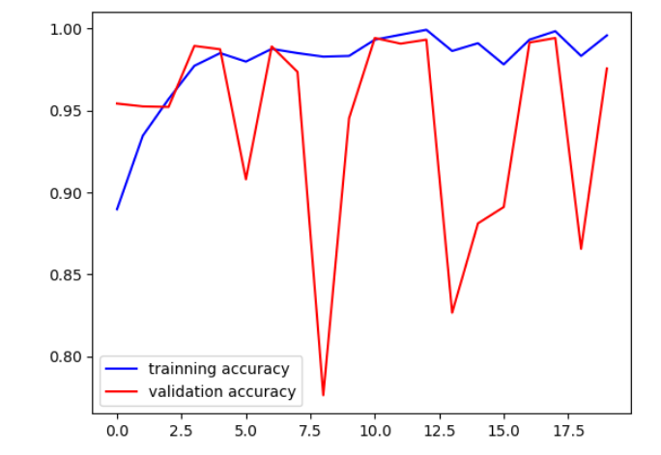
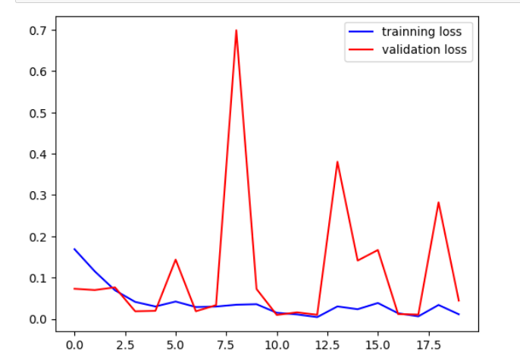
Results and comparison:
(DenseNet121)

Slide 8
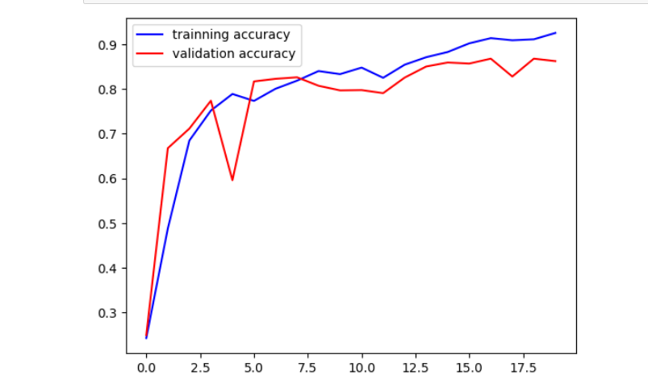
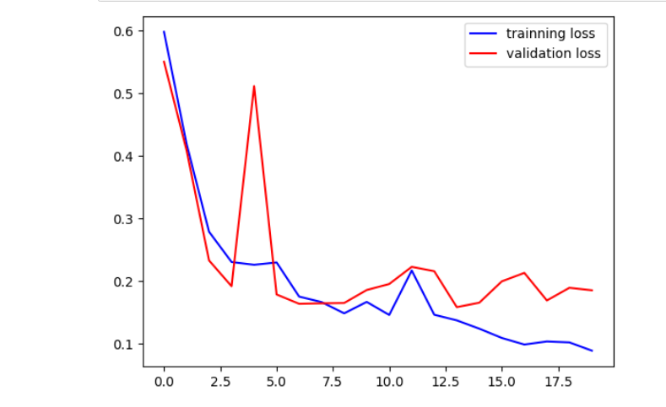
Results and comparison:
(VGG16)

Slide 9
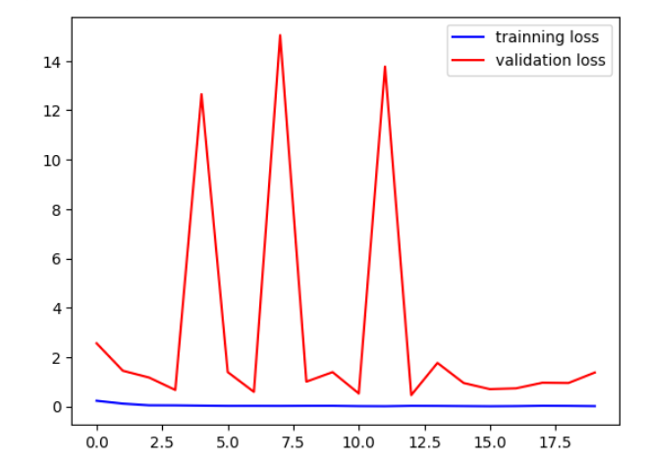
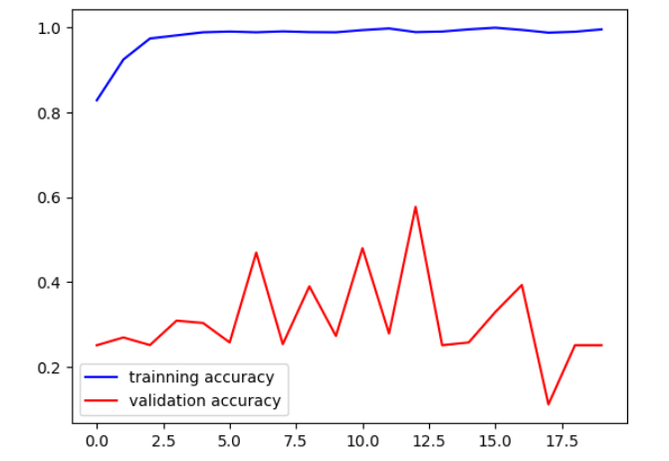
Results and comparison:
(EfficientNetB0)

Slide 10
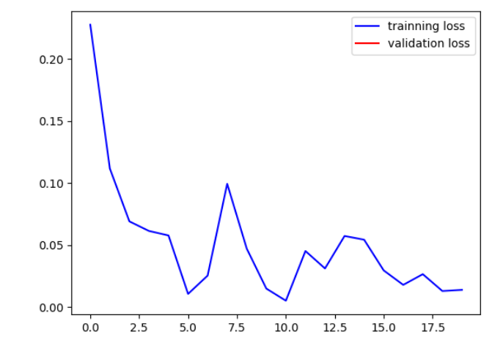
Results and comparison:
(InceptionResNetV2)

Slide 11
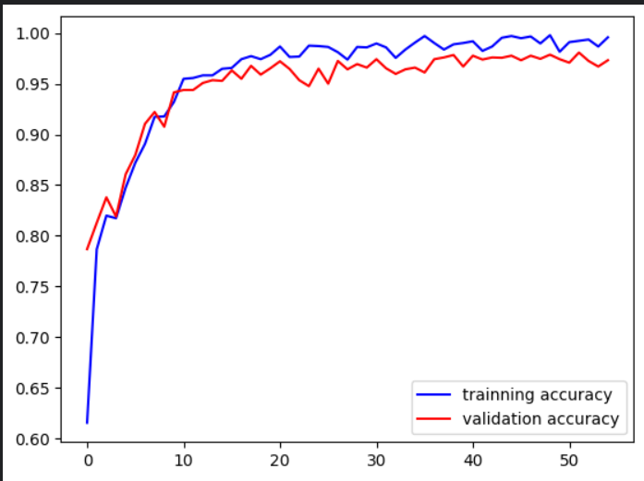
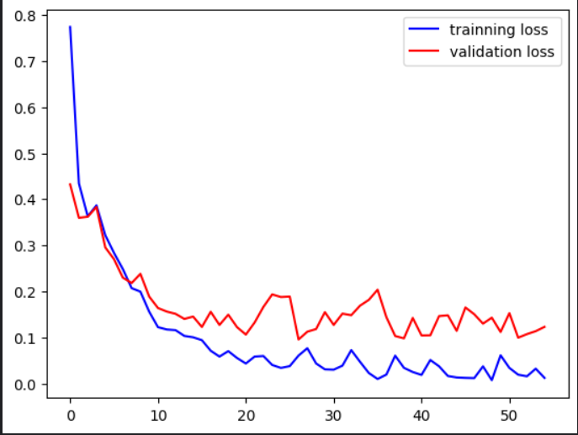
Results and comparison:
(CNNs)
Model accuracy&
validation accuracy:
training loss &
validation loss:

Slide 12

conclusion
Overall, developing a driver drowsiness detection system using neural networks and the Keras library using (CNNs) and transfer model, involves collecting and preprocessing a dataset of driver behavior, training a model to classify the driver's state based on input data from sensors, and deploying the model in a real-time system that alerts the driver if drowsiness is detected.

Slide 13

Thank you

